Slide 1
WCO · OWNED BRANDS · DATAVERS BRIEF
Uncover the signals to help WCO sellers win deals
and increase owned-brand margin.
A read-only, vendor-side intelligence and activity platform inside WCO, fit to Owned Brands’ mandate. It surfaces the signals and tracks our engagement, so the Owned Brands team engages the right opportunity at the right time.
surface signal → reach the right seller → win & hold margin → growth
Jeff Goodman · Director, Sales, Owned Brands · June 19, 2026 · Status: Discovery / wireframe

Slide 2
WHO WE ARE, AND WHAT DATA UNLOCKS
Insights surfaced at the right time increase margin company-wide
◉
◎
▤
We are the Owned Brands vendor team
Insight compounds our edge
A tool built for the vendor lens
WCO is our primary customer. We call on WCO sellers and select customers to help them win with owned brands.
We help WCO sellers compete and win with higher margins. More data sharpens that, spotting competitive pressure early and protecting margin.
What WCO’s ERP and CRM cannot do for a vendor, this tool does, lifting win rate and margin organization-wide.
The platform’s role: surface those signals and position the Owned Brands team where it can change the outcome.
Owned Brands Sales Intelligence Platform · Confidential / Internal · 2 / 10

Slide 3
IN PRACTICE
A deal we would lose today, and how the platform wins it
→
→
The deal
The threat
How we win
A WCO seller specified a security project around a national-brand camera line and secured registered project pricing. The rest of the bill of materials is still open.
A competing distributor bids the same cameras, but pairs them with its own-brand cable, power supplies, and racking. The extra margin on that hardware lets it beat our total price, despite our registered pricing.
The platform flags this seller. The OB team helps specify Owned Brands into the bill of materials, lifting margin and sharpening total price, so WCO keeps the deal.
Today no system surfaces this seller in time. Closing that gap is the platform’s core purpose.
Owned Brands Sales Intelligence Platform · Confidential / Internal · 3 / 10

Slide 4
THE ENGINE, OUR NORTH STAR
One loop moves a signal to a closed, higher-margin deal
→
→
→
1
2
3
4
Surface
Reach
Win
Grow
A signal in the governed data: a deal at risk or margin under pressure
The right WCO seller or customer, at the right time, with the cross and context
Help close the deal and protect owned-brand margin
Owned-brand share grows; the engagement is captured
The SKU is the spine. One detail view unifies sales, stock, opportunities, crosses, and activity. Two tiers run the model: the WCO seller channel (push) and WCO customers (pull).
Owned Brands Sales Intelligence Platform · Confidential / Internal · 4 / 10

Slide 5
WHAT YOU GET
A vendor-side platform and CRM, designed end to end
⇄
Cross database
◎
Signals + supply
☷
Vendor-lens CRM
Competitive product to owned-brand mapping. OB enablement, not org-wide access.
Where to engage: deals at risk, margin under pressure, and the supporting stock signal.
OB-generated opportunities and engagement with WCO sellers; intercompany activity the CRM cannot track.
✉
AI email-drop
▣
Leadership dashboard
▤
Inventory & forecast
A note becomes structured records; opportunity-loss and product signals.
Natural-language query over the whole pipeline.
Stock overlay with pipeline-weighted demand.
By design, read-only and in-tenant; margin/cost confined to the authorized OB group.
Owned Brands Sales Intelligence Platform · Confidential / Internal · 5 / 10

Slide 6
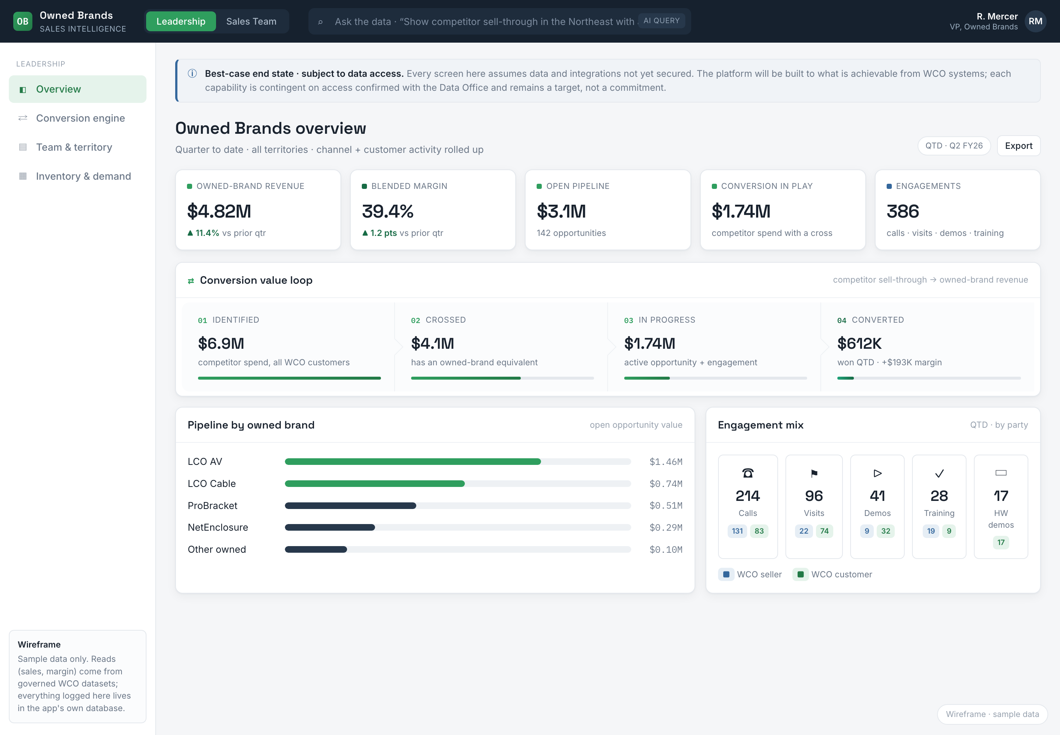
THE DESIGN
The leadership view, wireframed
1
Conversion value loop
Identified → crossed → in progress → converted, tracked live.
2
Pipeline by owned brand
LCO AV, LCO Cable and more, ranked by open opportunity.
3
Engagement by party
Calls, visits, demos logged for the WCO seller and customer.
A wireframe of the two-persona design (Leadership + Sales Team) on sample data. It shows the intended experience, not a built product.
Owned Brands Sales Intelligence Platform · Confidential / Internal · 6 / 10

Slide 7
WHY NOW
The team is built to execute; this tool is the growth engine
We have integrated the LCO sales organization, adding capability and aligning structure to the Owned Brands mandate inside WCO. The structure is in place and delivering today.
THE GROWTH CYCLE
Win the deal
↓
This tool turns what we are learning into a repeatable growth cycle, compounding that structural investment quarter over quarter.
Capture the lesson
↓
Sharpen the next play
Repeats, compounding every quarter.
Owned Brands Sales Intelligence Platform · Confidential / Internal · 7 / 10

Slide 8
ARCHITECTURE & GOVERNANCE
Governed end to end: read-only data in, the win out
→
→
→
WCO sources
Governed access
OB_Datavers
Dashboard, then the win
ERP (CORE)
CRM (USD)
Inventory
Certified datasets,
Power BI, or the
enterprise API layer
Cross-reference engine
Activity store, Azure SQL
AI layer, Azure OpenAI
Embedded Power BI
Seller signals surfaced
Spec owned brands, win
systems of record
read-only
isolated, in-tenant
Entra ID SSO · RBAC + row-level security · stays inside the Microsoft / Azure boundary, no egress
Not doing: no writes to the ERP or CRM, no direct DB connectivity, no duplication, no access outside OB, no egress.
Proposed and aligned to confirmed WCO Azure standards; the exact governed-data mechanism is confirmed with the Data Office before build.
Owned Brands Sales Intelligence Platform · Confidential / Internal · 8 / 10

Slide 9
THE PLAN
A phased build I can execute solo
0
1
2
3
4
Now
Access
Build
AI
Rollout
Scoping, wireframe, access one-pager, systems discovery
Secure read-only approval; confirm mechanism with Data Office
Azure production: data layer, app DB, identity, Power BI
Email-drop, datasheet crosses, natural-language query
Team adoption, education & sales-plan outputs
Phased by design: each phase is independently valuable and lowers the risk of the next.
Owned Brands Sales Intelligence Platform · Confidential / Internal · 9 / 10

Slide 10
THE ASK
Approve read-only access, an Azure environment, and governance liaisons
1
Read-only data access
Governed WCO sales data incl. margin/cost, via certified datasets, Power BI, or the API layer. User group: the Owned Brands sales team only. No access provided outside of OB.
2
Azure build environment
Subscription / resource group under WCO governance, Entra ID app registration, Azure OpenAI in-tenant, and a Power BI workspace with certified-dataset read access.
3
Governance liaisons
Named contacts from Data Office, BI Governance, Cloud Engineering, and IT Security, plus confirmation of the access-request workflow and margin/cost classification.
Not requested: writes to the ERP or CRM, direct DB connectivity, data duplication, access outside OB, or any egress.
Approve these, and the Owned Brands team can see the signals and act on them.

